Slide 1






Machine learning
Cours 2 : un premier exemple
David Rousseau

Slide 2
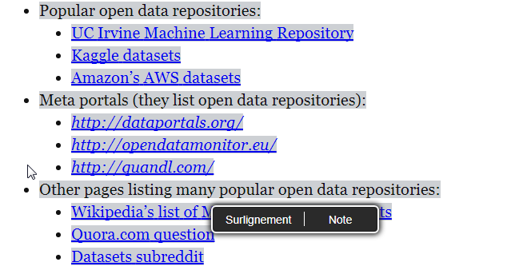
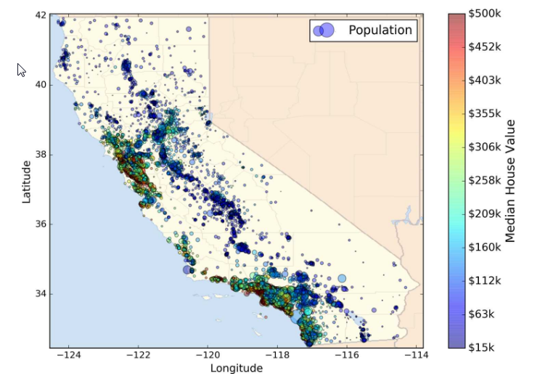
Data basis
Here are a few places where you can find data sets:
In this course we choose California prizing from Statlib depository

Slide 3
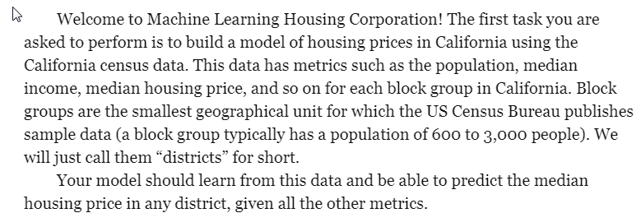
End to end project
To start with go to your ML check list

Slide 4
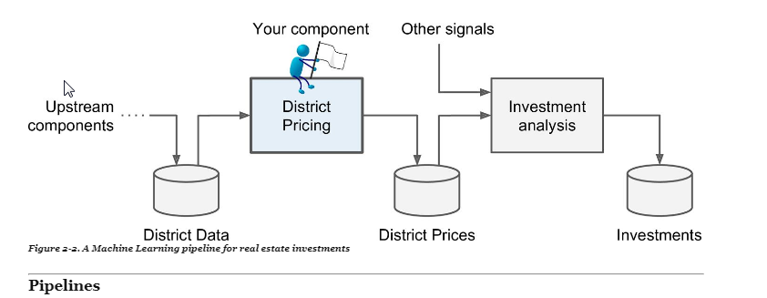
First questions
What is the final goal ?
What is the current existing solution ?
What kind of machine learning is this ? Supervised, unsupervised, reinforcement learning,
Classification, regression, something else ? Should we use batch learning online learning ?

Slide 5
Answer
This is supervised learning: we have houses with the corresponding price
This is regression : the data to predict (price) can take any continuous value
This is a multivariate regression : the prediction is based on multiple factor
This is batch learning : the information comes once in a year, no need for online learning

Slide 6
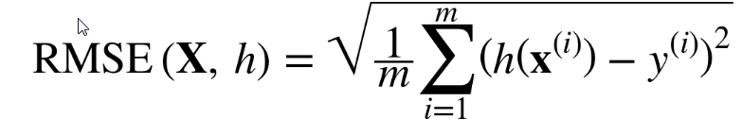
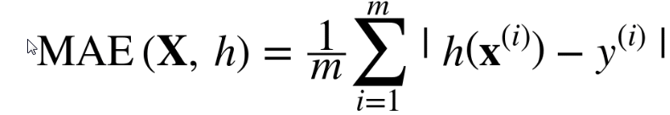
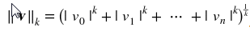
Performance metrics for regression
m number of instances in the dataset
x(i) is a vector of all the feature values of the ith instance in the dataset
y(i) is the desired output for that instance
X is a matric containing all the vector x
h is the system’s prediction function which receives x(i) and gives h(x(i)) the estimated y(i)
RMSE (root mean square error) based on L2 norm while MAE (mean absolute error) based on L1 norm
More generally norm lk
The higher the norm index, the more it focuses on large values and neglects small ones
RMSE is more sensitive to outliers than MAE

Slide 7
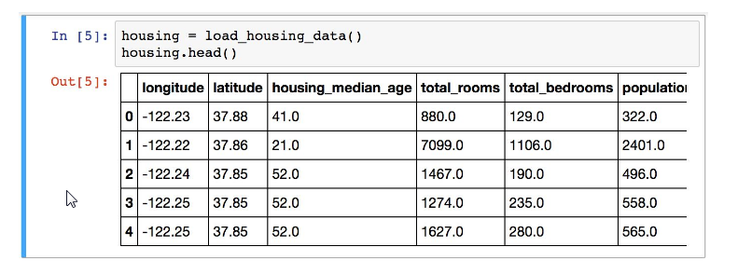
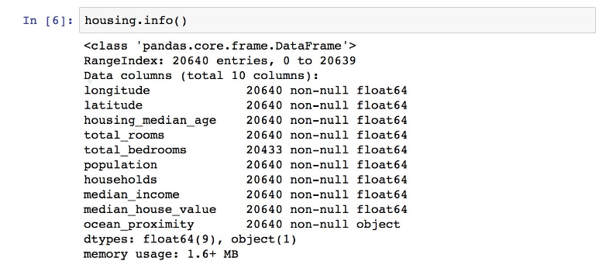
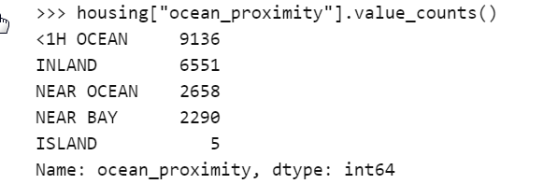
Get the data and observe
Download them and open them : see notebook

Slide 8
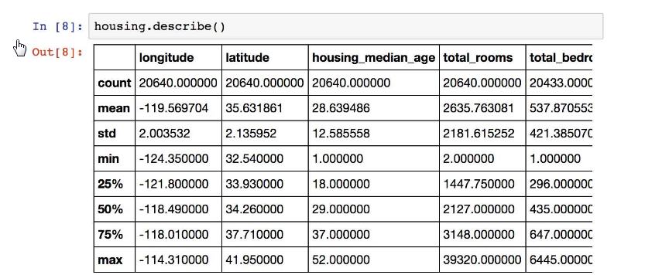
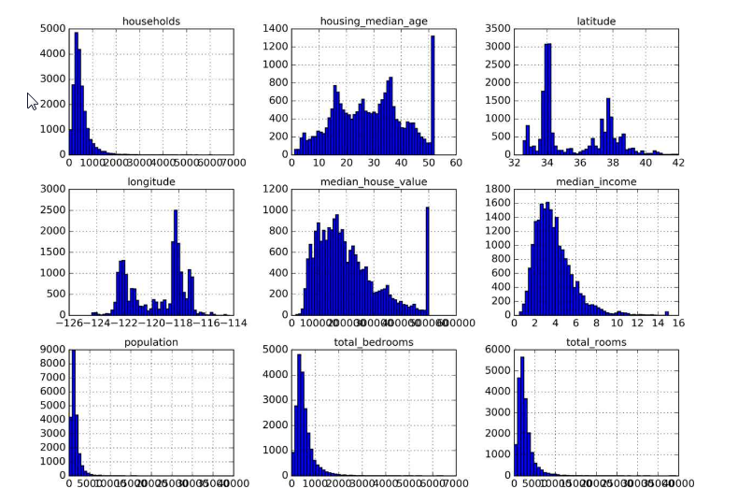
Have a statistical view on them
Percentile: is a measure used in statistics indicating the value below which a given percentage of observations in a group of observations fall.
Histograms.

Slide 9
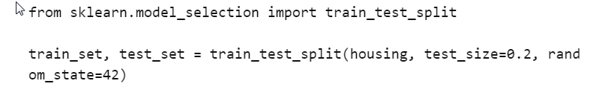
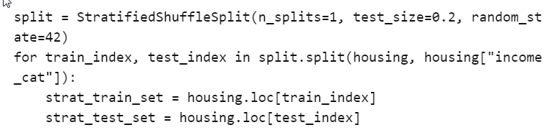
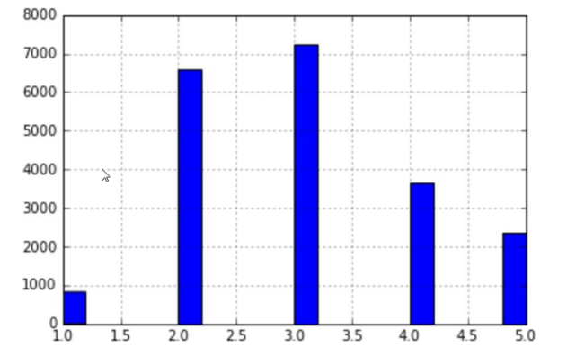
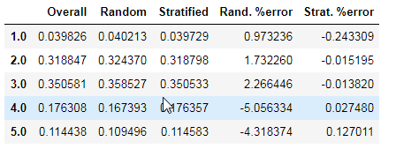
Before analyzing more… create test set
This is random sampling
Other strategies : stratified sampling to account for structure in the data and avoid bias

Slide 10
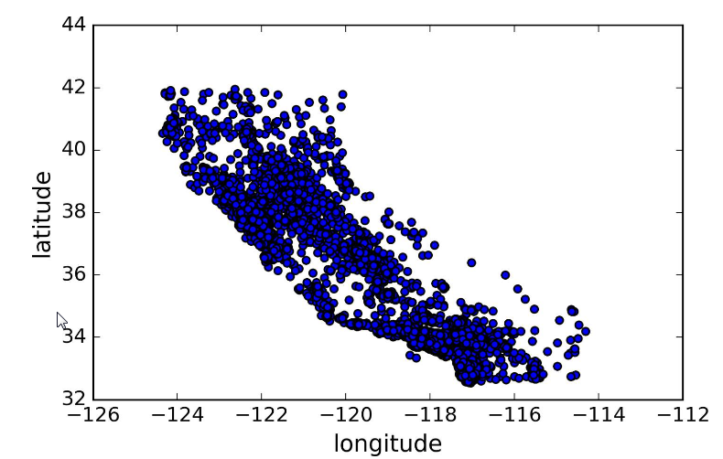
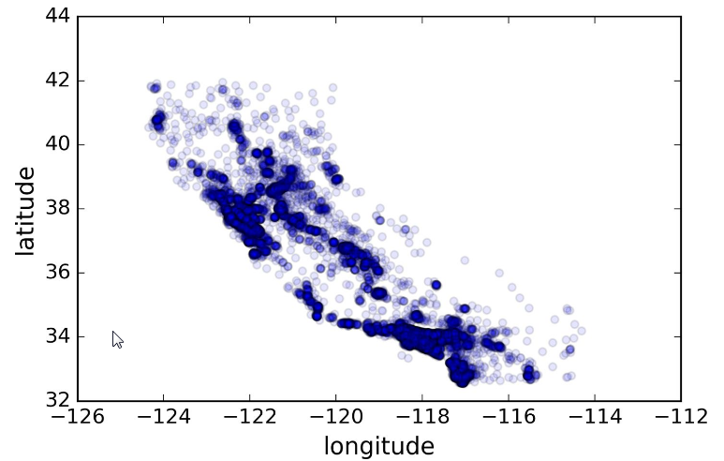
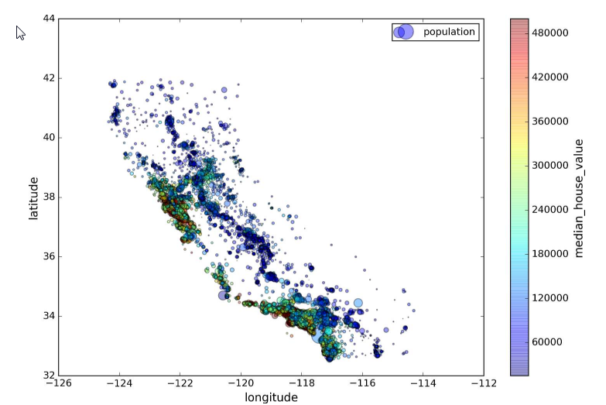
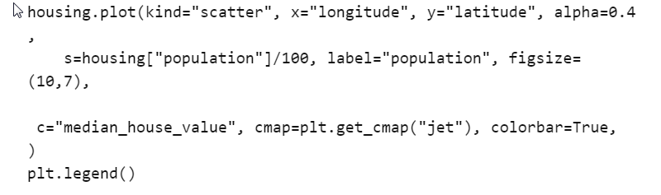
Discover and analyze the data to gain insight
Price is high close to the ocean in highly dense population area

Slide 11
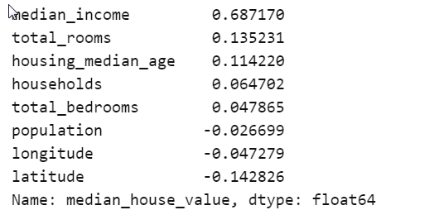
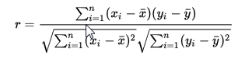
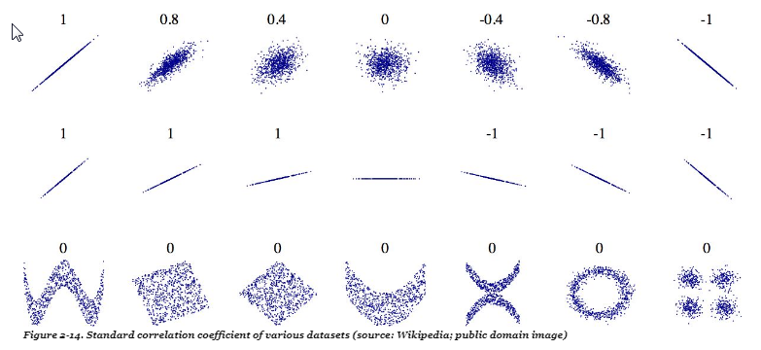
Look for correlations
Pearson coefficient between two parameters x and y
Limit of the Pearson coefficient

Slide 12
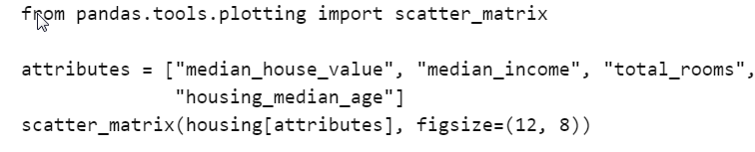
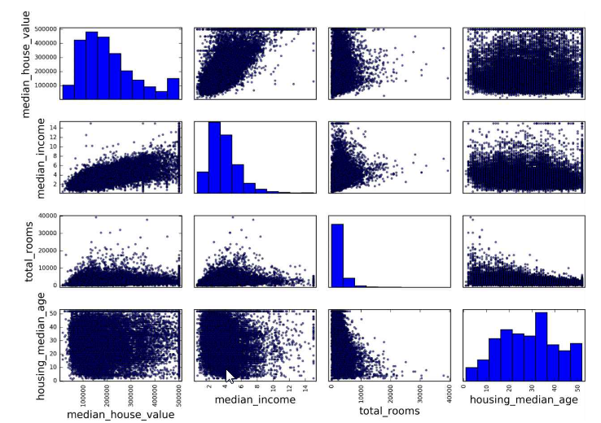
Looking for structure

Slide 13
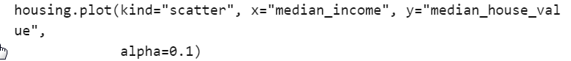
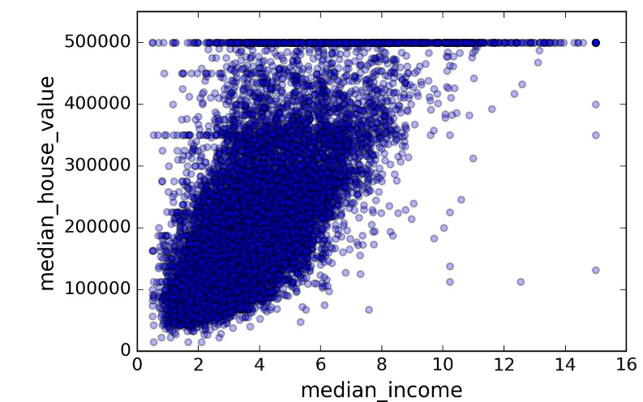
Identify the most important parameter

Slide 14
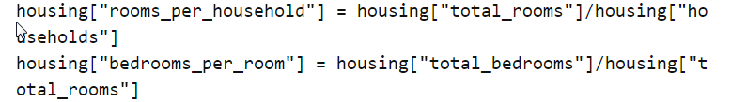
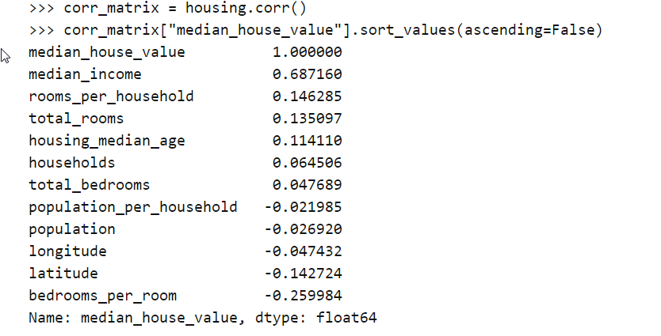
Experiment with attribute combination
Total number of rooms in a district is not very useful if you don’t know how many households there are
Total number of bedroom not useful if not compared to the number of rooms
Let’s create new attributes:
The number of room per_Household increase with the price

Slide 15
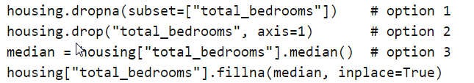
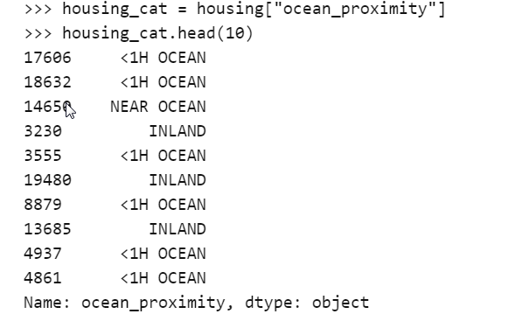
Prepare data for machine learning
Most machine learning algorithms cannot work with missing features
Three options :
Get rid of data with missing features
Get rid of the whole attribute
Set the values to some value (zero, the mean, the media,,…)
Most machine learning algorithm work with figures instead of strings of character

Slide 16
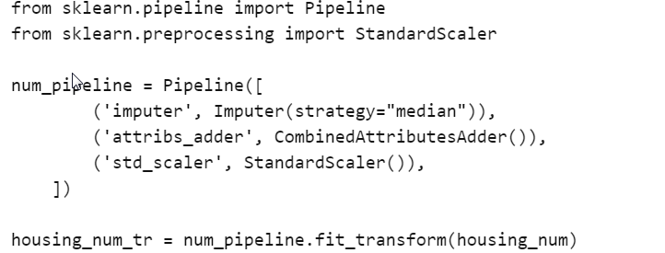
Feature scaling
Most machine learning algorithms don’t perform well when input numerical attributes have very different scales
This is the case for the housing data: number of room 6 to 39 while medina incomes only range from 0 to 15
Common ways to have the same scale:
min-max linear scaling : setting data between 0 and 1
Standardization : subtract the mean and divide by the standard deviation (less sensitive to outlier than Min-max scaling)
Possible to pipeline all the transformation in a single pipeline

Slide 17
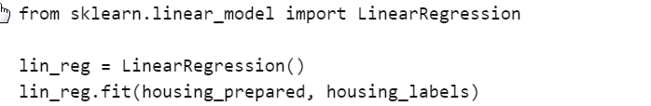
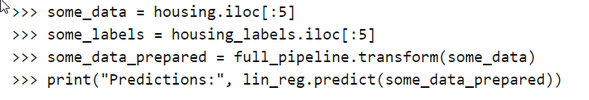
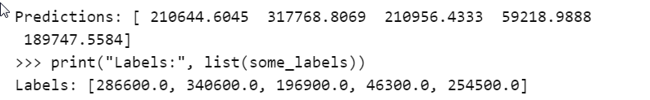
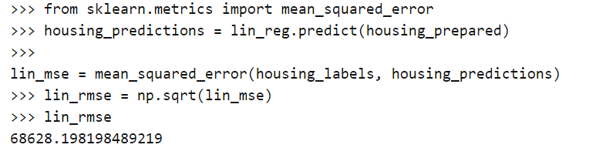
Select and train a model
Not excellent since price is between 120 000 and 250 000

Slide 18
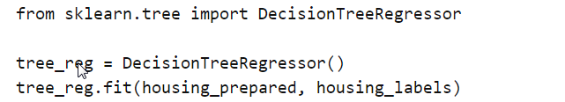
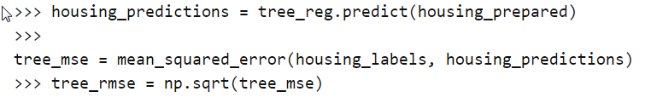
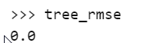
Select and train a model
Smells like overfitting

Slide 19
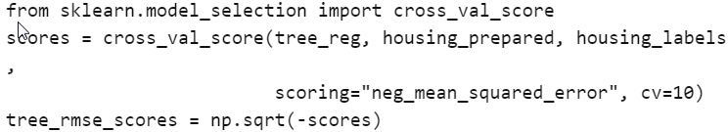
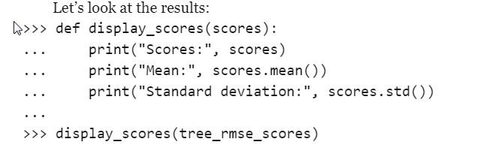
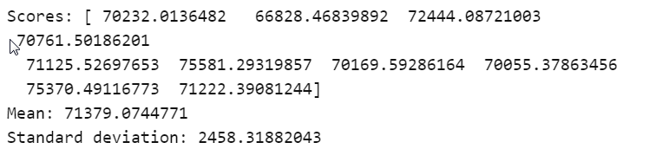
Better evaluation by cross-validation
Worse than linear regression

Slide 20
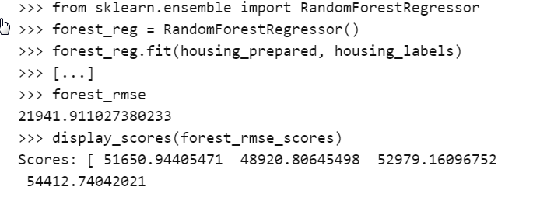
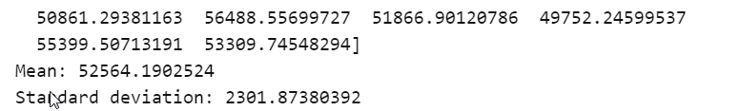
Another regressor
Still some overfitting since a big difference between training and testing

Slide 21
Fine tuning of models
Assume you have found some reasonably promissing systems
You might want to optimize it
Different approaches:
Automatic grid search of the system’s parameters
Combine the different systems in an ensemble way

Slide 22
Test on the test data set

Slide 23
Next course
Classification
David Rousseau

